Slide 1




Clean oddly shaped surfaces around your house while protecting yourself from bacteria and cleaning chemicals.
Group 18 Saikeerthana Bobba, Surya Jayakumar, Melany Vargas Salas, Vishnu Kariyattu, Abraham Guerrero

Slide 2
Agenda
NEED ARTICULATION (IDENTIFICATION OF THE PROBLEM)
TARGET CUSTOMER IDENTIFIED
CONCEPT ARTICULATION
CUSTOMER VALUE PROPOSITION
MARKET SIZE ＆ INDUSTRY STRUCTURE ANALYSIS
DIFFERENTIATION＆ COMPETITIVE ADVANTAGE
INTEGRATED VALUE CREATION, VALUE DELIVERY ＆ VALUE CAPTURE LOGIC
FINANCIAL ＆ INTEGRATED SUSTAINABILITY MODEL
HUMAN RESOURCE ACQUISITION STRATEGY
TEAM SELF ASSESTMENT
APPENDIX

Slide 3
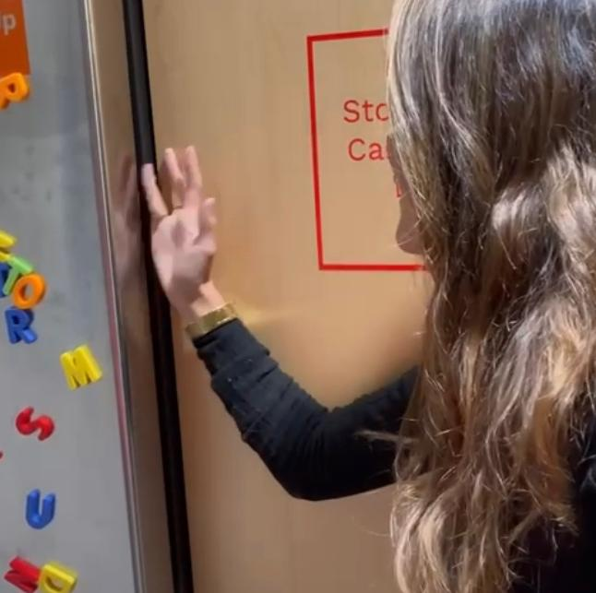
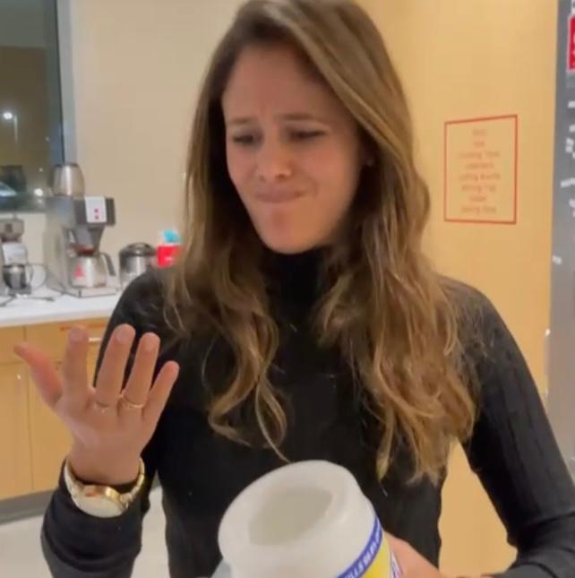




Need Articulation
Pain points
“The Cleaning Conundrum”
“It is hard to clean surfaces like the kitchen cabinets”
A common cleaning problem
Portfolio Designed
“I don´t like the chemicals touching my skin!”
Oddly shaped surfaces
How can we help people clean oddly shaped surfaces while avoiding direct contact with bacteria and cleaning agents?
Unfavorable contact

Slide 4
Target customer
71 people interviewed
1
*Reported problem cleaning odd surfaces
*73%
Stay at home Mom
*Reported problem touching chemicals
*90%
3
2
*42%
Professional cleaner
Young
Professional
*67%
*14%
*95%

Slide 5
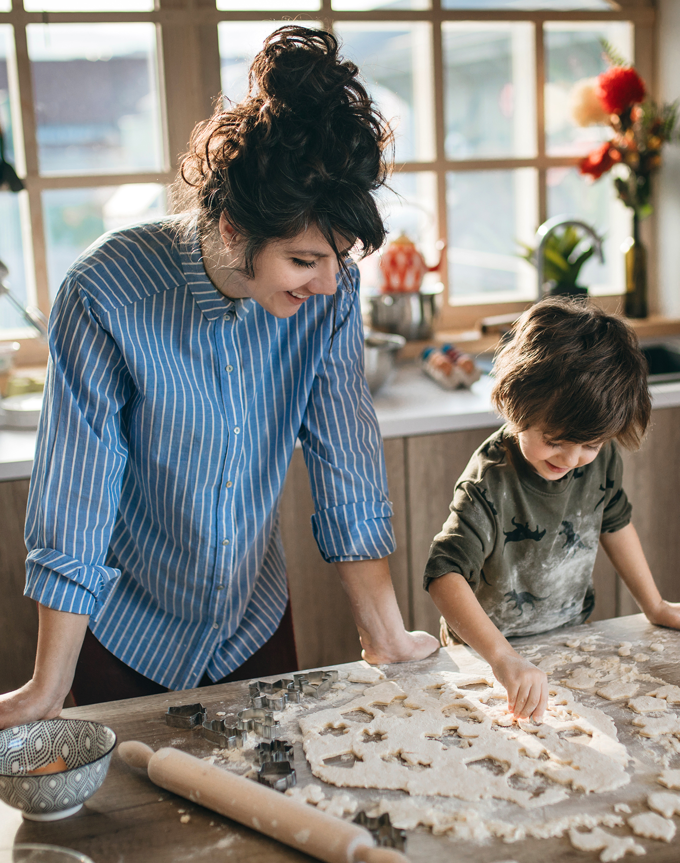
Target customer
Customer Persona:
The “Stay at home” Mom
BIO –
Early 20’s to Late 40’s
Children living at home
Focused on families' needs (cleaning included)
Other points of interest –
Possibly a working mom
Familiar with local stores and online shopping
Familiar with cleaning products available
Pain Points –
Needs to be certain that Kitchen and Bathroom specially are 100% bacteria free
Does not want family exposed to strong chemicals, does not want chemicals to touch skin
Does not have infinite time to clean
Is not aware there is a better alternative to cleaning surfaces with a rag, paper towel or wipe
3

Slide 6
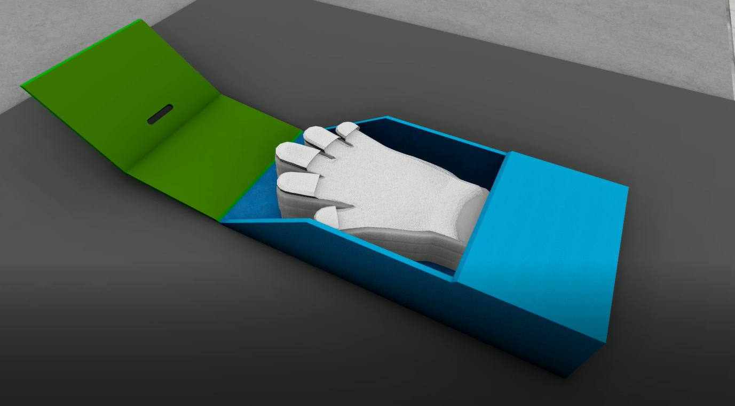
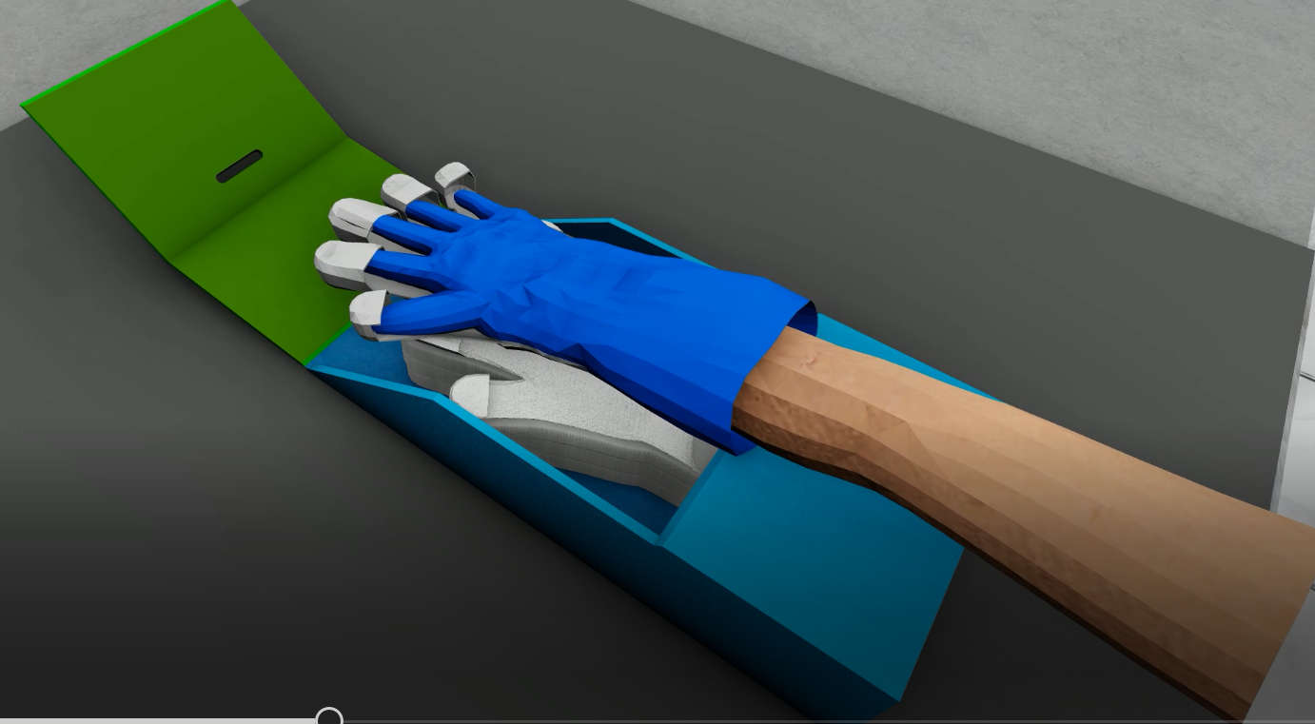
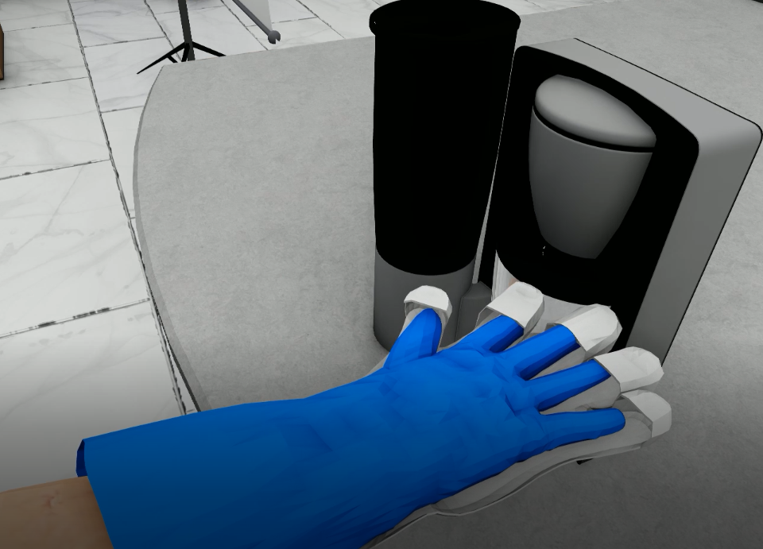
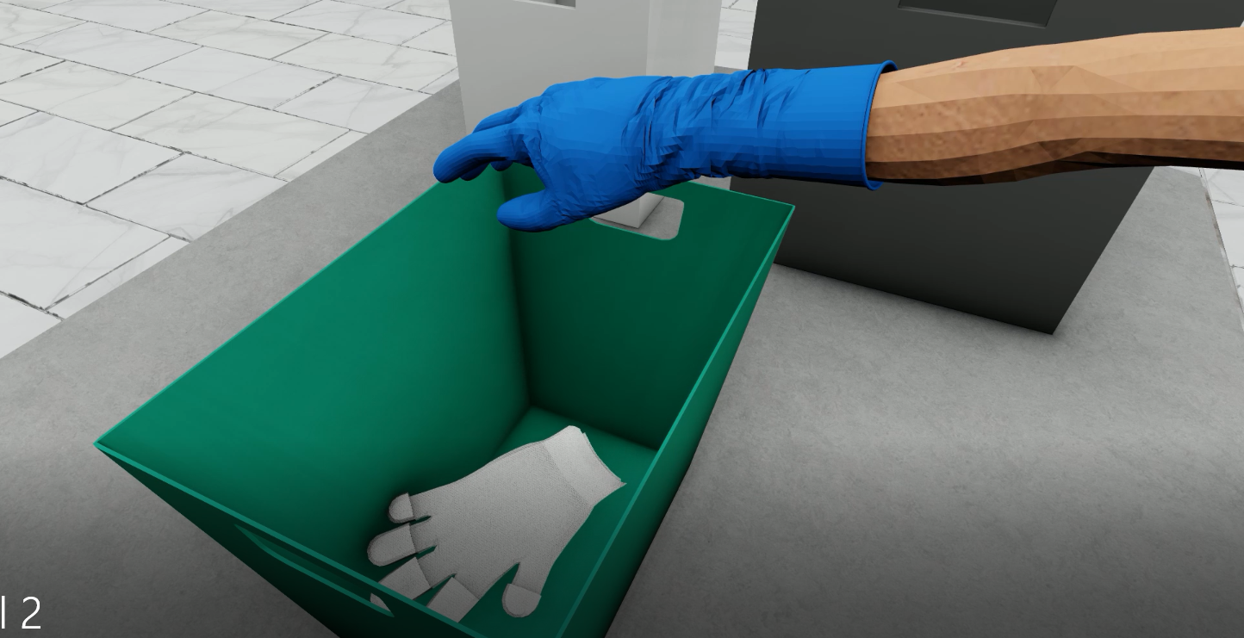
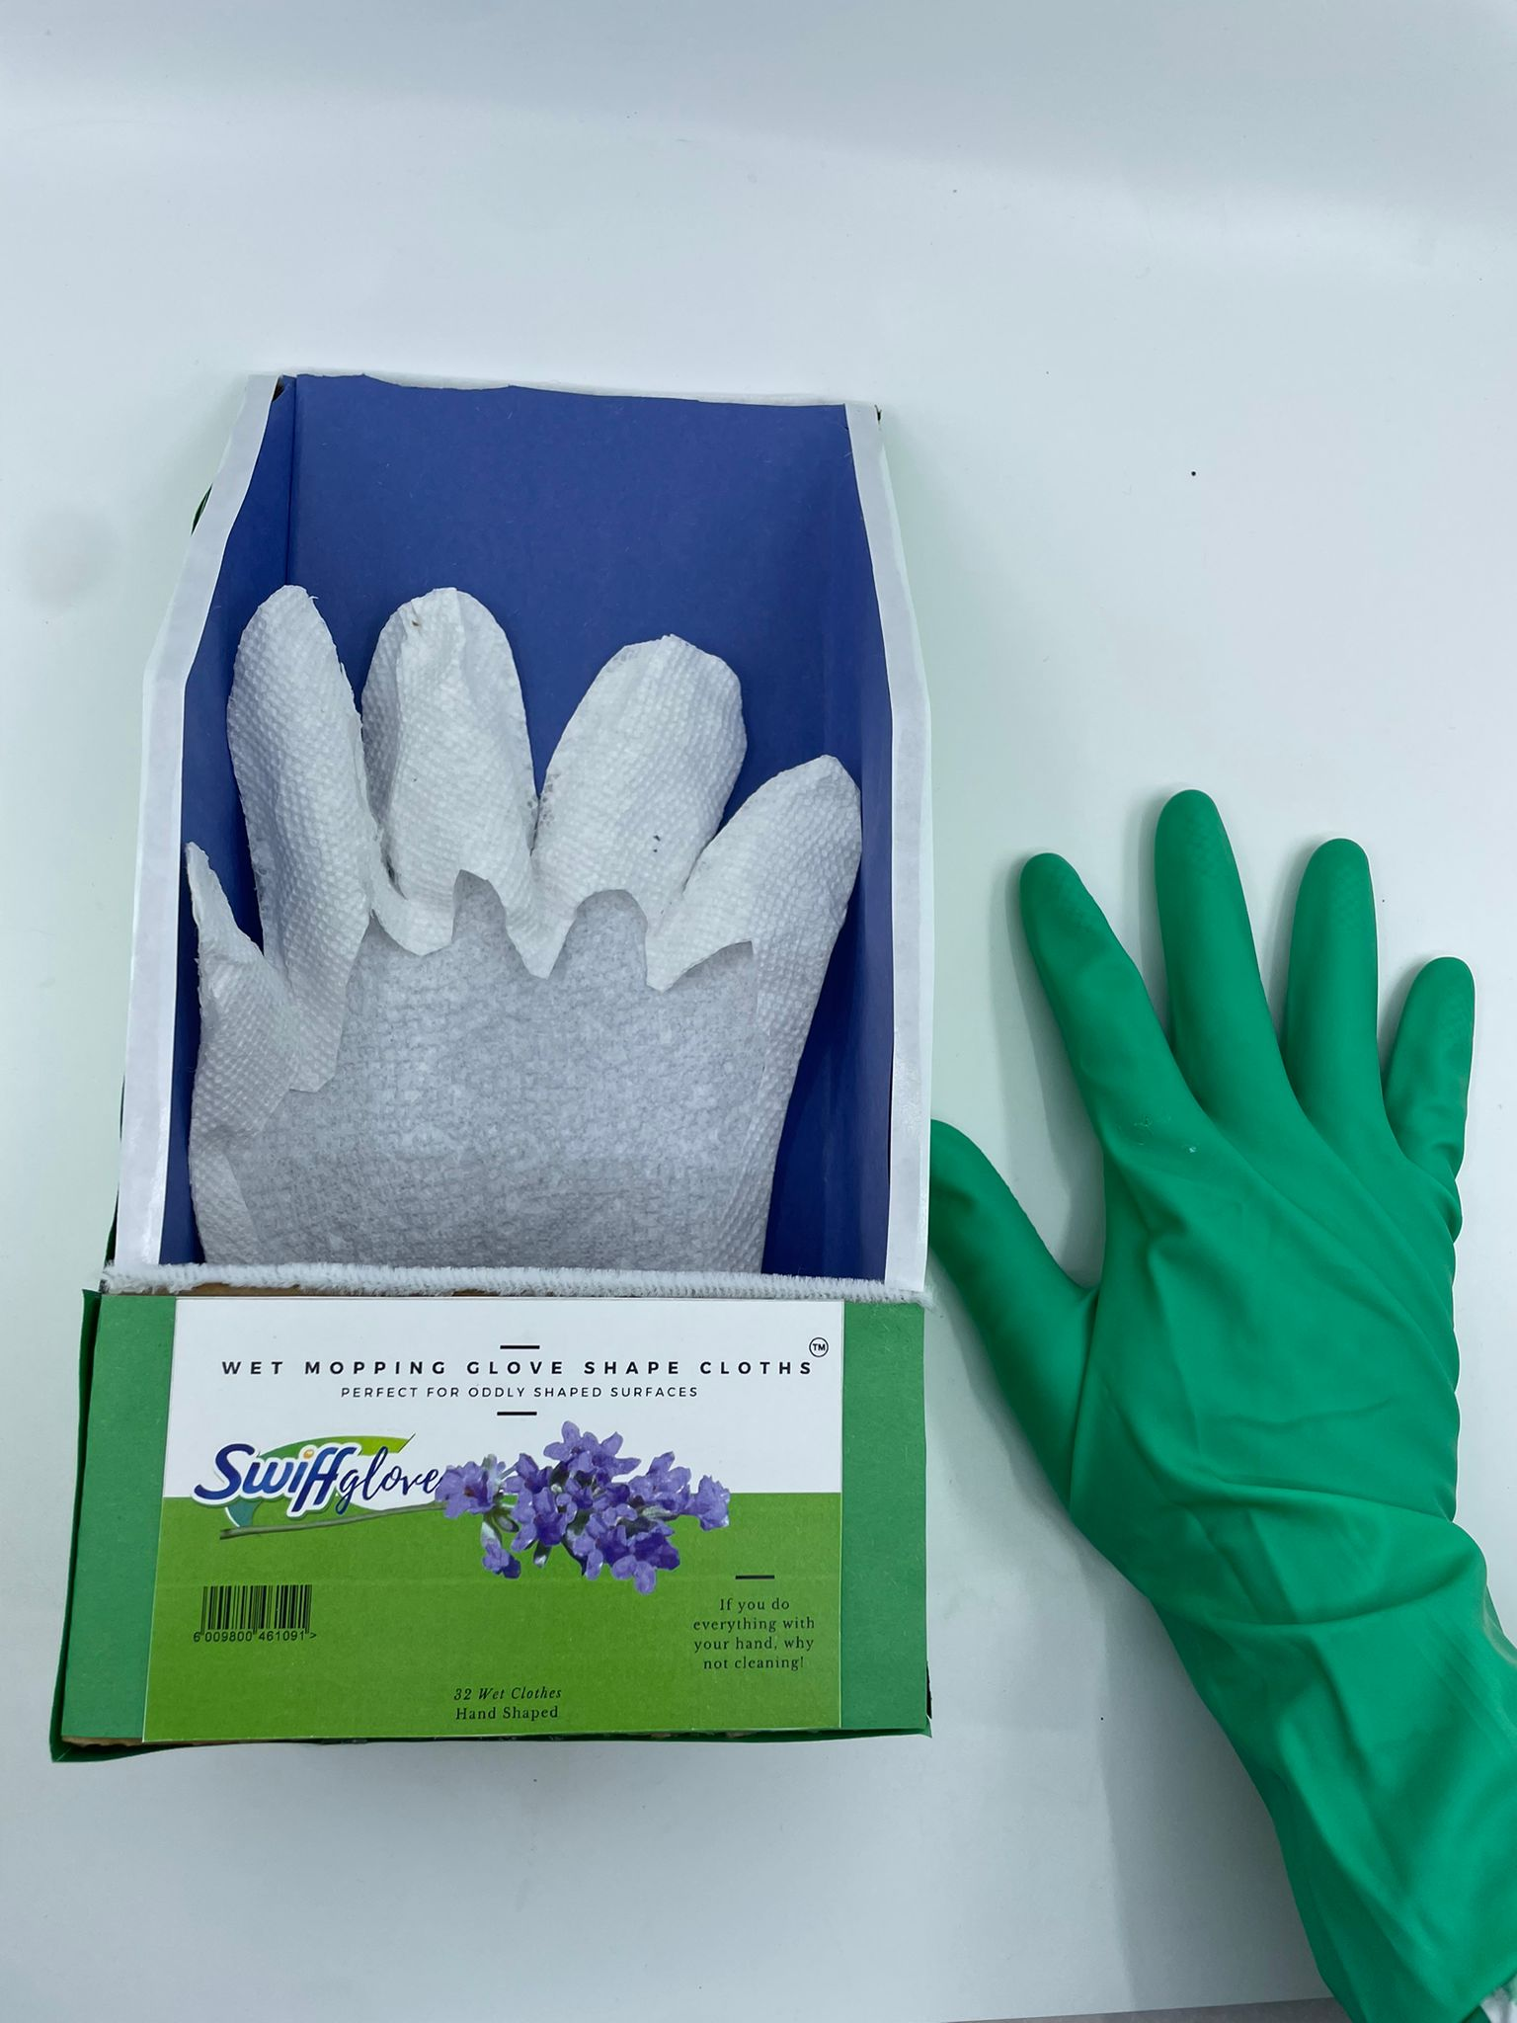
Concept Articulation
1
2
This glove has attachable wipes which stick on and peel off easily, allowing you to intuitively clean oddly shaped surfaces and crevices with your hands.
Put the glove
Place your hand on the wipe
3
4
Clean
Dispose
4

Slide 7
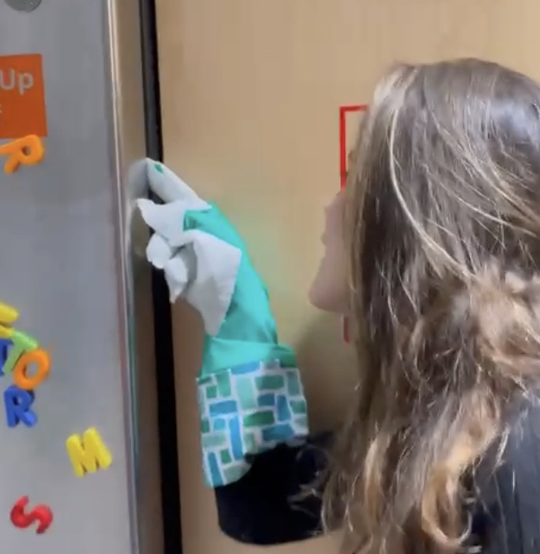


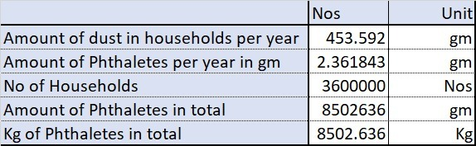
Value proposition (CVP)
#3 Measure UN Goals “Good Health”
Dust might contain harmful chemicals like phthalates which can enter the body through the skin and damage the immune system.
Studies suggest that dust might also contain the cancer-causing agent TDCIPP.
Its hand shaped utility allows you to clean oddly shaped surfaces
Avoids contact with chemicals and bacteria
Saves time and is easy to throw away
Allows you to control how much pressure to apply in the cleaning process
The Swiffglove is a cleaning tool for people who seek intuitive cleaning solutions that can clean oddly shaped surfaces unlike standard cleaning wipes.
Our product is a glove with attachable wet/dry wipe options that can stick on, peel off and disposed easily.
5

Slide 8






Industry structure Analysis
Wet/dry wipes Industry
Industry rivalry
MEDIUM
Threat of new entrants:
Aggressive competition for share
Compete not on price but differentiation
LOW
Big players benefit from economies of scale. Difficult for a new player to penetrate
Many players: difficult for a new competitor to find shelf space at the retailers.
Threat of Substitutes
HIGH
Many alternatives available (paper towels, rags)
Established and efficient distribution channels, which reduces operating costs.
Bargaining power of suppliers
LOW
MEDIUM
Bargaining power of buyers:
Many suppliers vs low concentration of industry players.
Chemical / commodity manufacturers: inability to differentiate
product
Larger retailers have more influence because of large purchases
Brand recognition and loyalty from end customers.
6

Slide 9


Differentiation ＆ competitive advantage
Competitive Matrix
Scott paper
towel
SwiffGlove
Features
Swiffer
Lysol wipes
Clorox wipes
Swiff Glove
Wet and Dry
Compatibility
Avoids contact with Chemicals
Cleaning oddly shaped surfaces
Total wipes required to disinfect 4 sq ft
2
5
4
3
3
Quick and convenient
Consumer friendly
Intuitive and sanitary
Market positioning
Disinfectant
Disinfectant
Pricing (Unit wipe)
0.39
0.37
0.2
0.23
0.4
7

Slide 10
Value delivery, Value create ＆ Value capture
Capabilities
CVP
- Cleans oddly shaped surfaces
- Protects from chemicals/bacteria
- Availability of Wipe & Velcro tech
- Marketing & Cost Mgmt Expertise
Value chain
Market Positioning
- Logistics & Procurement from P&G
- Big box retail channel to be used
- Intuitive and easy to use
- Safety from all health hazards
Financial Model
- Razor and cartridge model
- Retail Margins at 50% to push sales
Financial Footprint
- Low investment from P&G expertise
- Massive expansion due to P&G
8

Slide 11

Market size
$212 Thousand
2021
$27 Millions
2022
$54 Millions
2023
Predicted growth rate from 2021 to 2028
9

Slide 12
Financial ＆ Integrated Sustainability model
Income statement | Net sales (Millions) | COGS | Gross Margin | R&D | Adv | Other SG&A | Operating Margin
Year-1 | 1.34 | 41% | 59% | 956% | 183% | 373% | -1454%
Year-2 | 171 | 41% | 59% | 6.3% | 36% | 15% | 1.6%
Year-3 | 342 | 41% | 59% | 2.5% | 12% | 15% | 29.7%
KPI | Benchmark | Year
Organic Sales growth | 7% | Y2
Core EPS growth | 3% | Y2
Adjusted FCF Productivity | 93% | Y2
Retail Price - $10
Wholesale Price - $5
Initial Investment - $28M
Break-even point –87,000 units
25%-Fixed assets
75%-Working capital needs
10

Slide 13
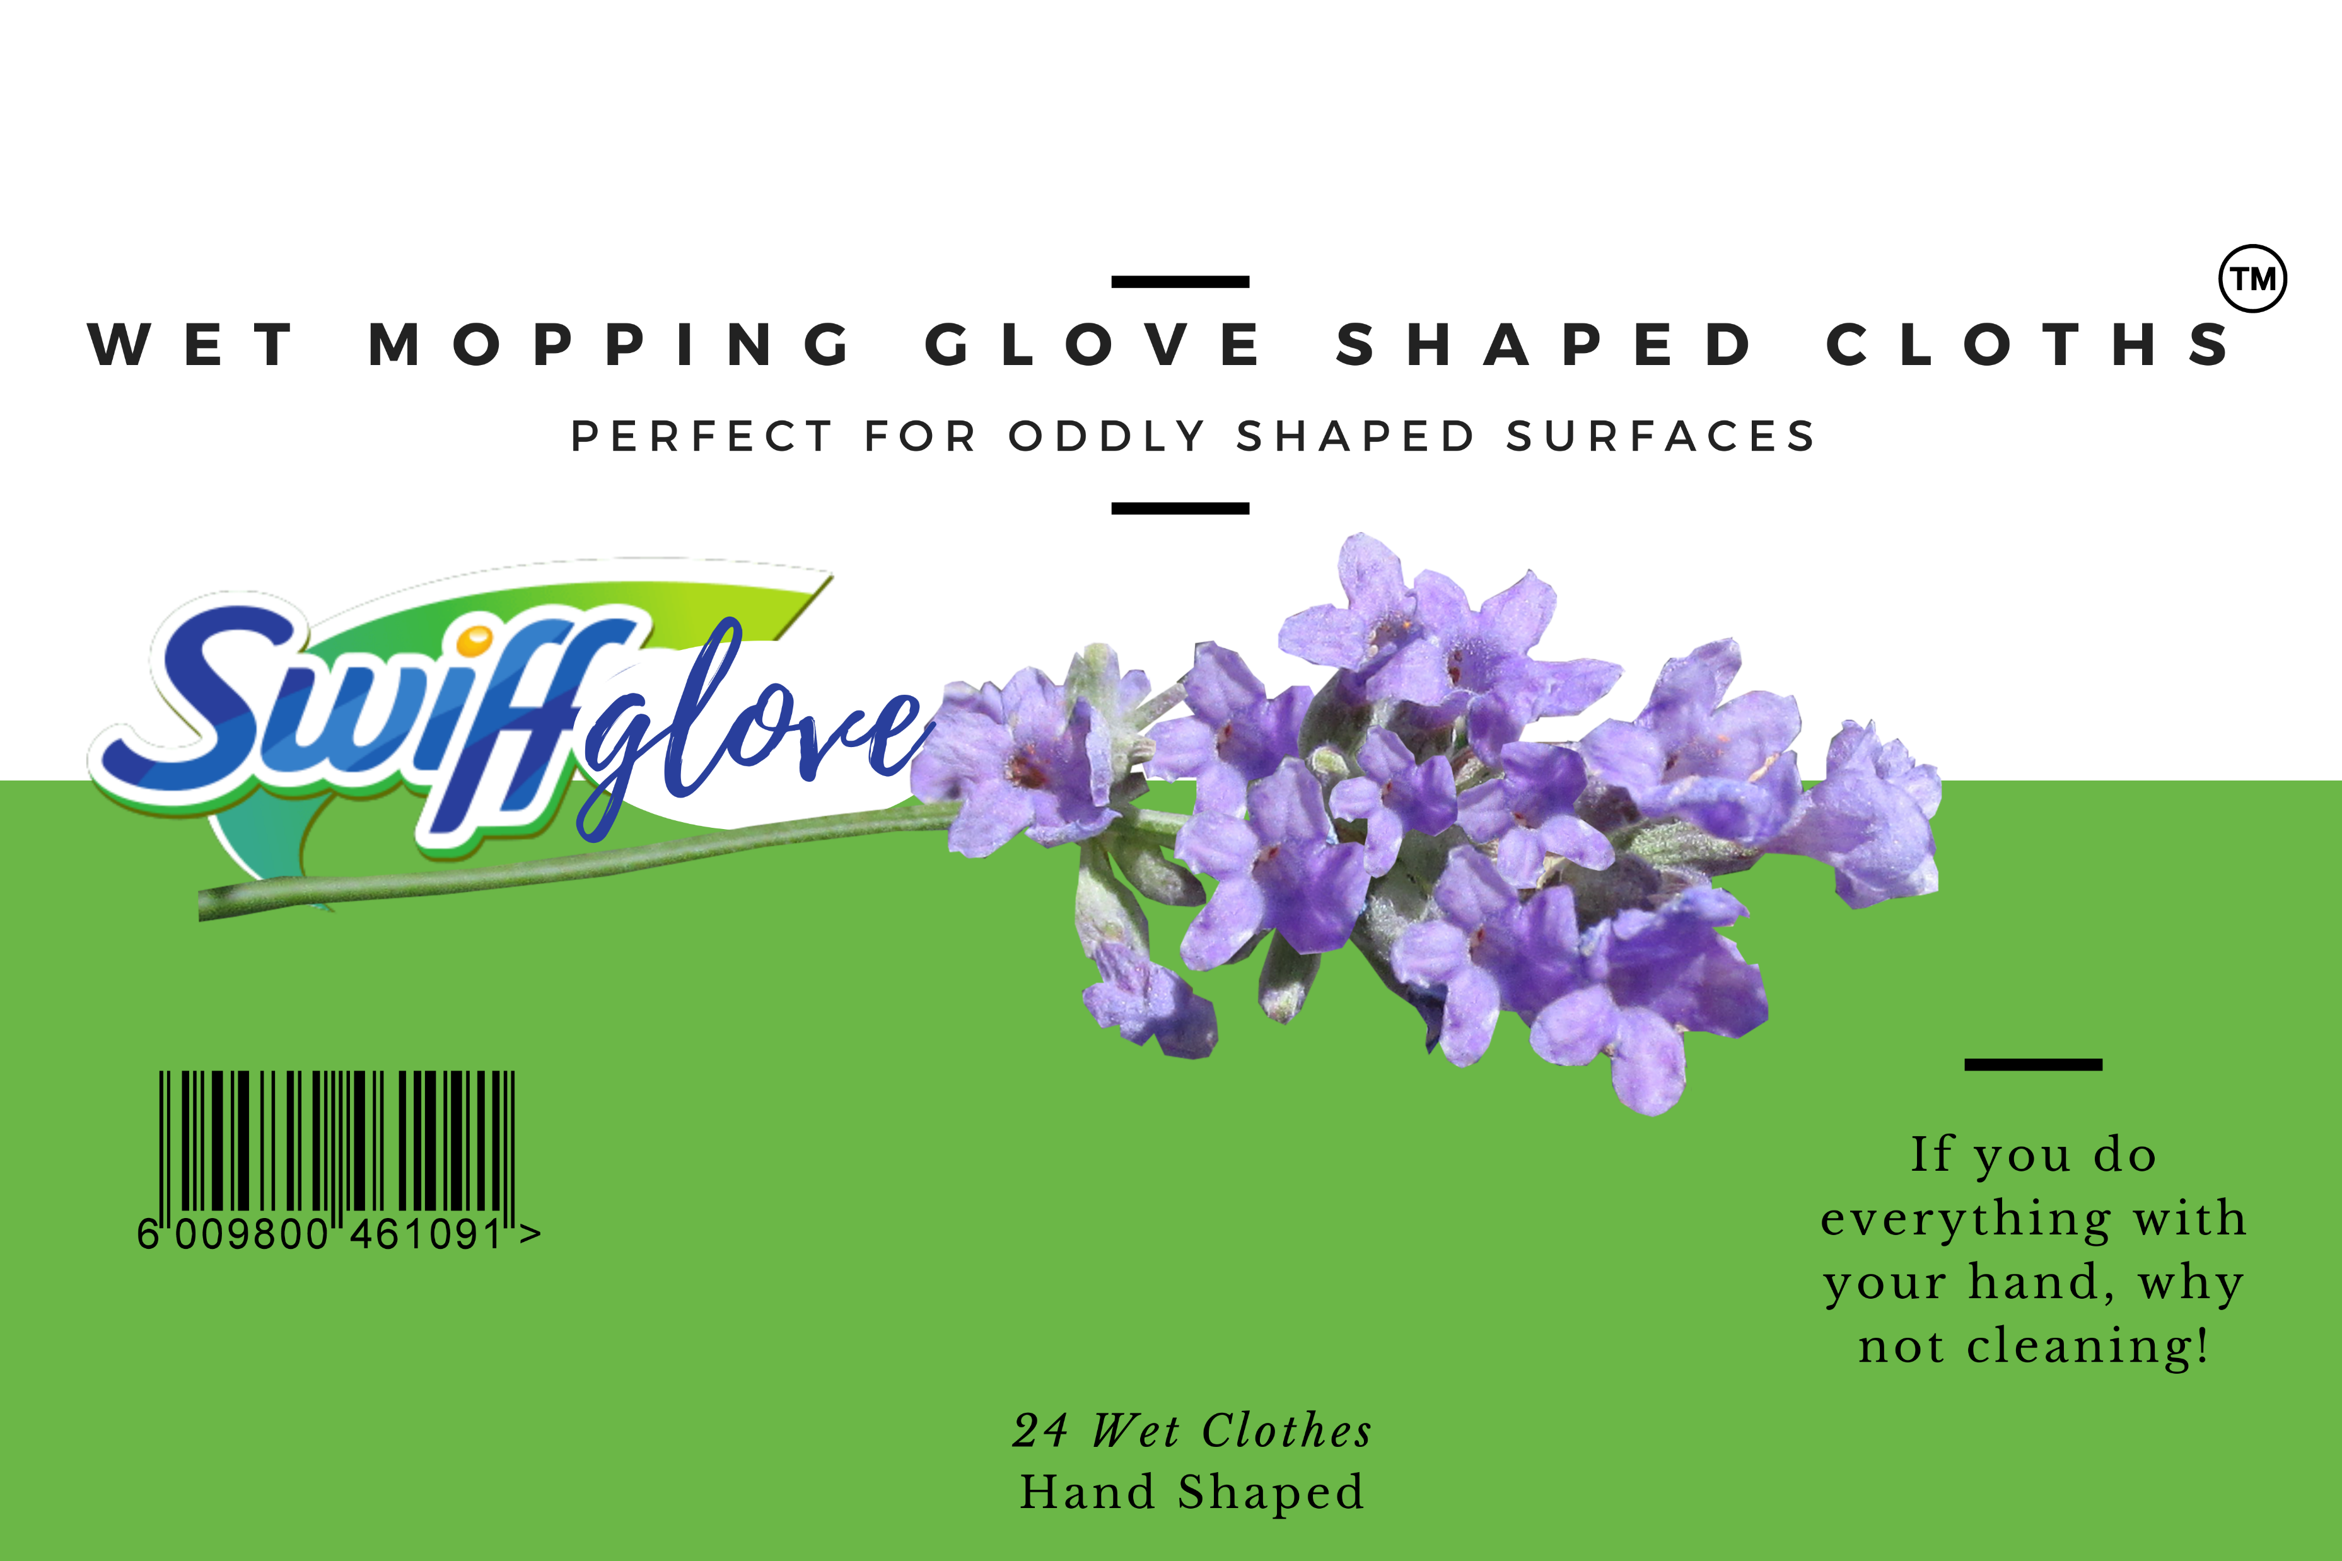

Slide 14
Apendix
Apendix | Slide
Human resource acquisition Strategy | Page 13
Team self Assesment | Page 14
3 Personas | Page 15, 16 and 17
Initial Feedback of the product | Page 18
Customer Journey Map | Page 19
Price willingness to pay | Page 20
Potential areas of growth | Page 21 and 22
Target customer frequency | Page 23
Customer cleaning frequency | Page 24
Business Model Canvas | Page 25
Bibliography | Page 26
12

Slide 15
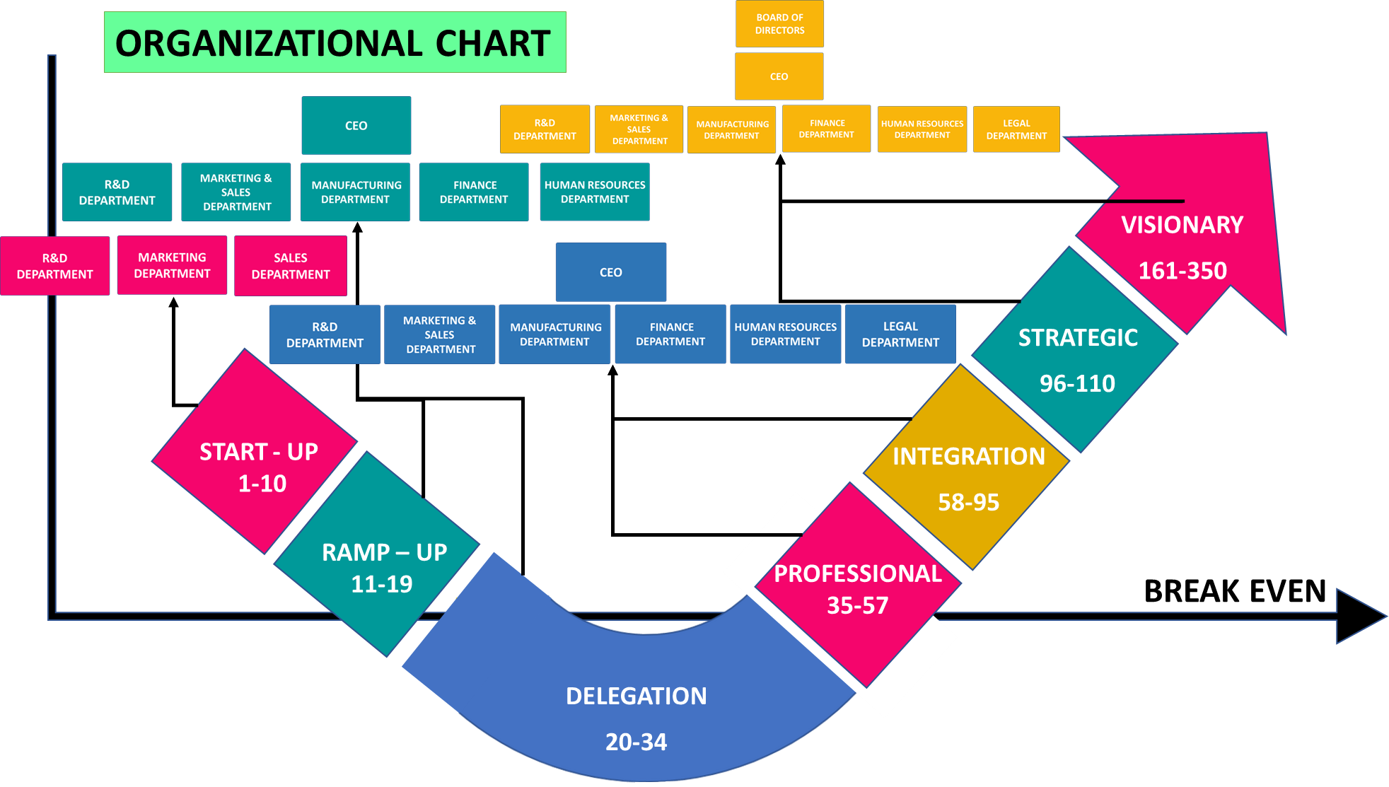
Human resource acquisition Strategy
13

Slide 16
Team self Assesment
We discuss, brainstorm, decide and work together so that we understand the outcome as a whole rather than dividing work into smaller parts.
If we are not satisfied with the end result, we always hold the team accountable rather than the individuals accountable.
We as a team wants to have continuous learning curve and always concentrated on growing better by taking up actions which we are not good at and excelling in it.
We encourage open-ended discussions and active problem solving in meetings rather than winding it up in a hurry.
We have appropriate mix of talent in our group whose insights are shaping up this effective journey and we are excited to take this forward to module-2.
14

Slide 17








Personas
Pascale
Persona 1
Bio
Quote
Goals
Pain points
Train her children properly
Believes chemical-based cleaning products might be harmful to family
“Stay at home” Mom
Loves her family
“I can’t clean between the cabinets with the Swiffer!”
Build unbreakable family bonds
There is no device that clean all oddly shaped surfaces around the house
Prefers chemical based products for bathroom, but gentle products for kitchen
Believes cleaning rags spread germs around surfaces
39
years old
Loves a clean house
Personality and Interests
Reasons to use and buy this product
Behaviors
Cleaning use
Life stage:
Raising
children
Focused on children’s education
Promotes life values to children
She tends to clean her house 4 or 5 times a week
Makes children clean along with her
Differentiates cleaning by location: Bathrooms, kitchen, living rooms, and bedrooms
Uses a variety of cleaning products, and wipes surfaces with Lysol wipes and paper towels.
Uses:
Broom, Swiffer, Lysol wipes, glass cleaners,
Vacuums and mops
Attracted to product ability to clean oddly shaped surfaces
Sees product as quick and convenient
Attracted to separation product provides
Cost-sensitive and uses products judiciously
15

Slide 18
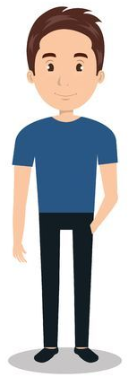
Personas
Christian
Persona 2
Bio
Quote
Goals
Pain points
The wipes slips in the hands
The wipes slips in the hands
The wipes slips in the hands
The wipes slips in the hands
The wipes slips in the hands
The wipes slips in the hands
“I don’t like touching Lysol wipes with my hands because the chemicals get on my hands”
The wipes slips in the hands
The wipes slips in the hands
Form a family in the future
Earn more money
Needs a one stop shop for cleaning products
Needs a quick solution to cleaning
Does not see value in expensive cleaning products
Prefers an environ-mentally friendly solution
Finish his studies
Needs to save some money
Needs to save money
Needs to save money
Does not spend much time at home
Needs to save money
Needs to save money
Young professional
29
year old
Friendly with environment
Single; lives by himself
Personality and Interests
Behaviors
Cleaning use
Reasons to use and buy this product
Life stage:
Very busy studying and working
Loves Music and hanging out with friends
Tries to clean as fast as possible
Focuses on the living room and bathroom
Loves Sports
Uses
vacuum, Swiffer, wipes and air fresheners
Starts by wiping away dust, then wiping all surfaces with Lysol Wipes
Will protect him from touching unclean surfaces in bathroom
Our product is decently priced
Our product is multi use
Does not clean frequently because he is not home that often
Is not an experienced cleaner; unfamiliar with products
The wipes slips in the hands
The wipes slips in the hands
Intuitive, fast product; not complex or multi step
Needs to save money
16

Slide 19
Personas
Christian
Persona 3
Bio
Quote
Goals
Pain points
“I feel like it should be easier to clean, I take a long-time cleaning those little spaces between the windows”
Be independent and work hard towards that goal
Extremely dirty surfaces that are hard to reach require better and easier ways to clean
She wishes she could use products that disinfect with chemicals, but the place where she works prefer natural products
There are many cleaning products but non are all purpose
Professional Cleaner
45
years old
Hard worker
Personality and Interests
Reasons to use and buy this product
Behaviors
Cleaning use
Life stage:
Working everyday
Likes to watch TV in her free time
She usually uses many products to clean
As a professional she does not buy her own products
Uses Swiffer, paper towels, disinfectant, wipes, Lysol and a broom plus a mop
To clean small surfaces, she uses a wipes but can not clean small places
Our product will help her clean all surfaces
Our product will help her perform her job faster
Our product will be easy to use and intuitive
She has a defined cleaning routine
Due to constant cleaning, she must protect hands with gloves
17

Slide 20

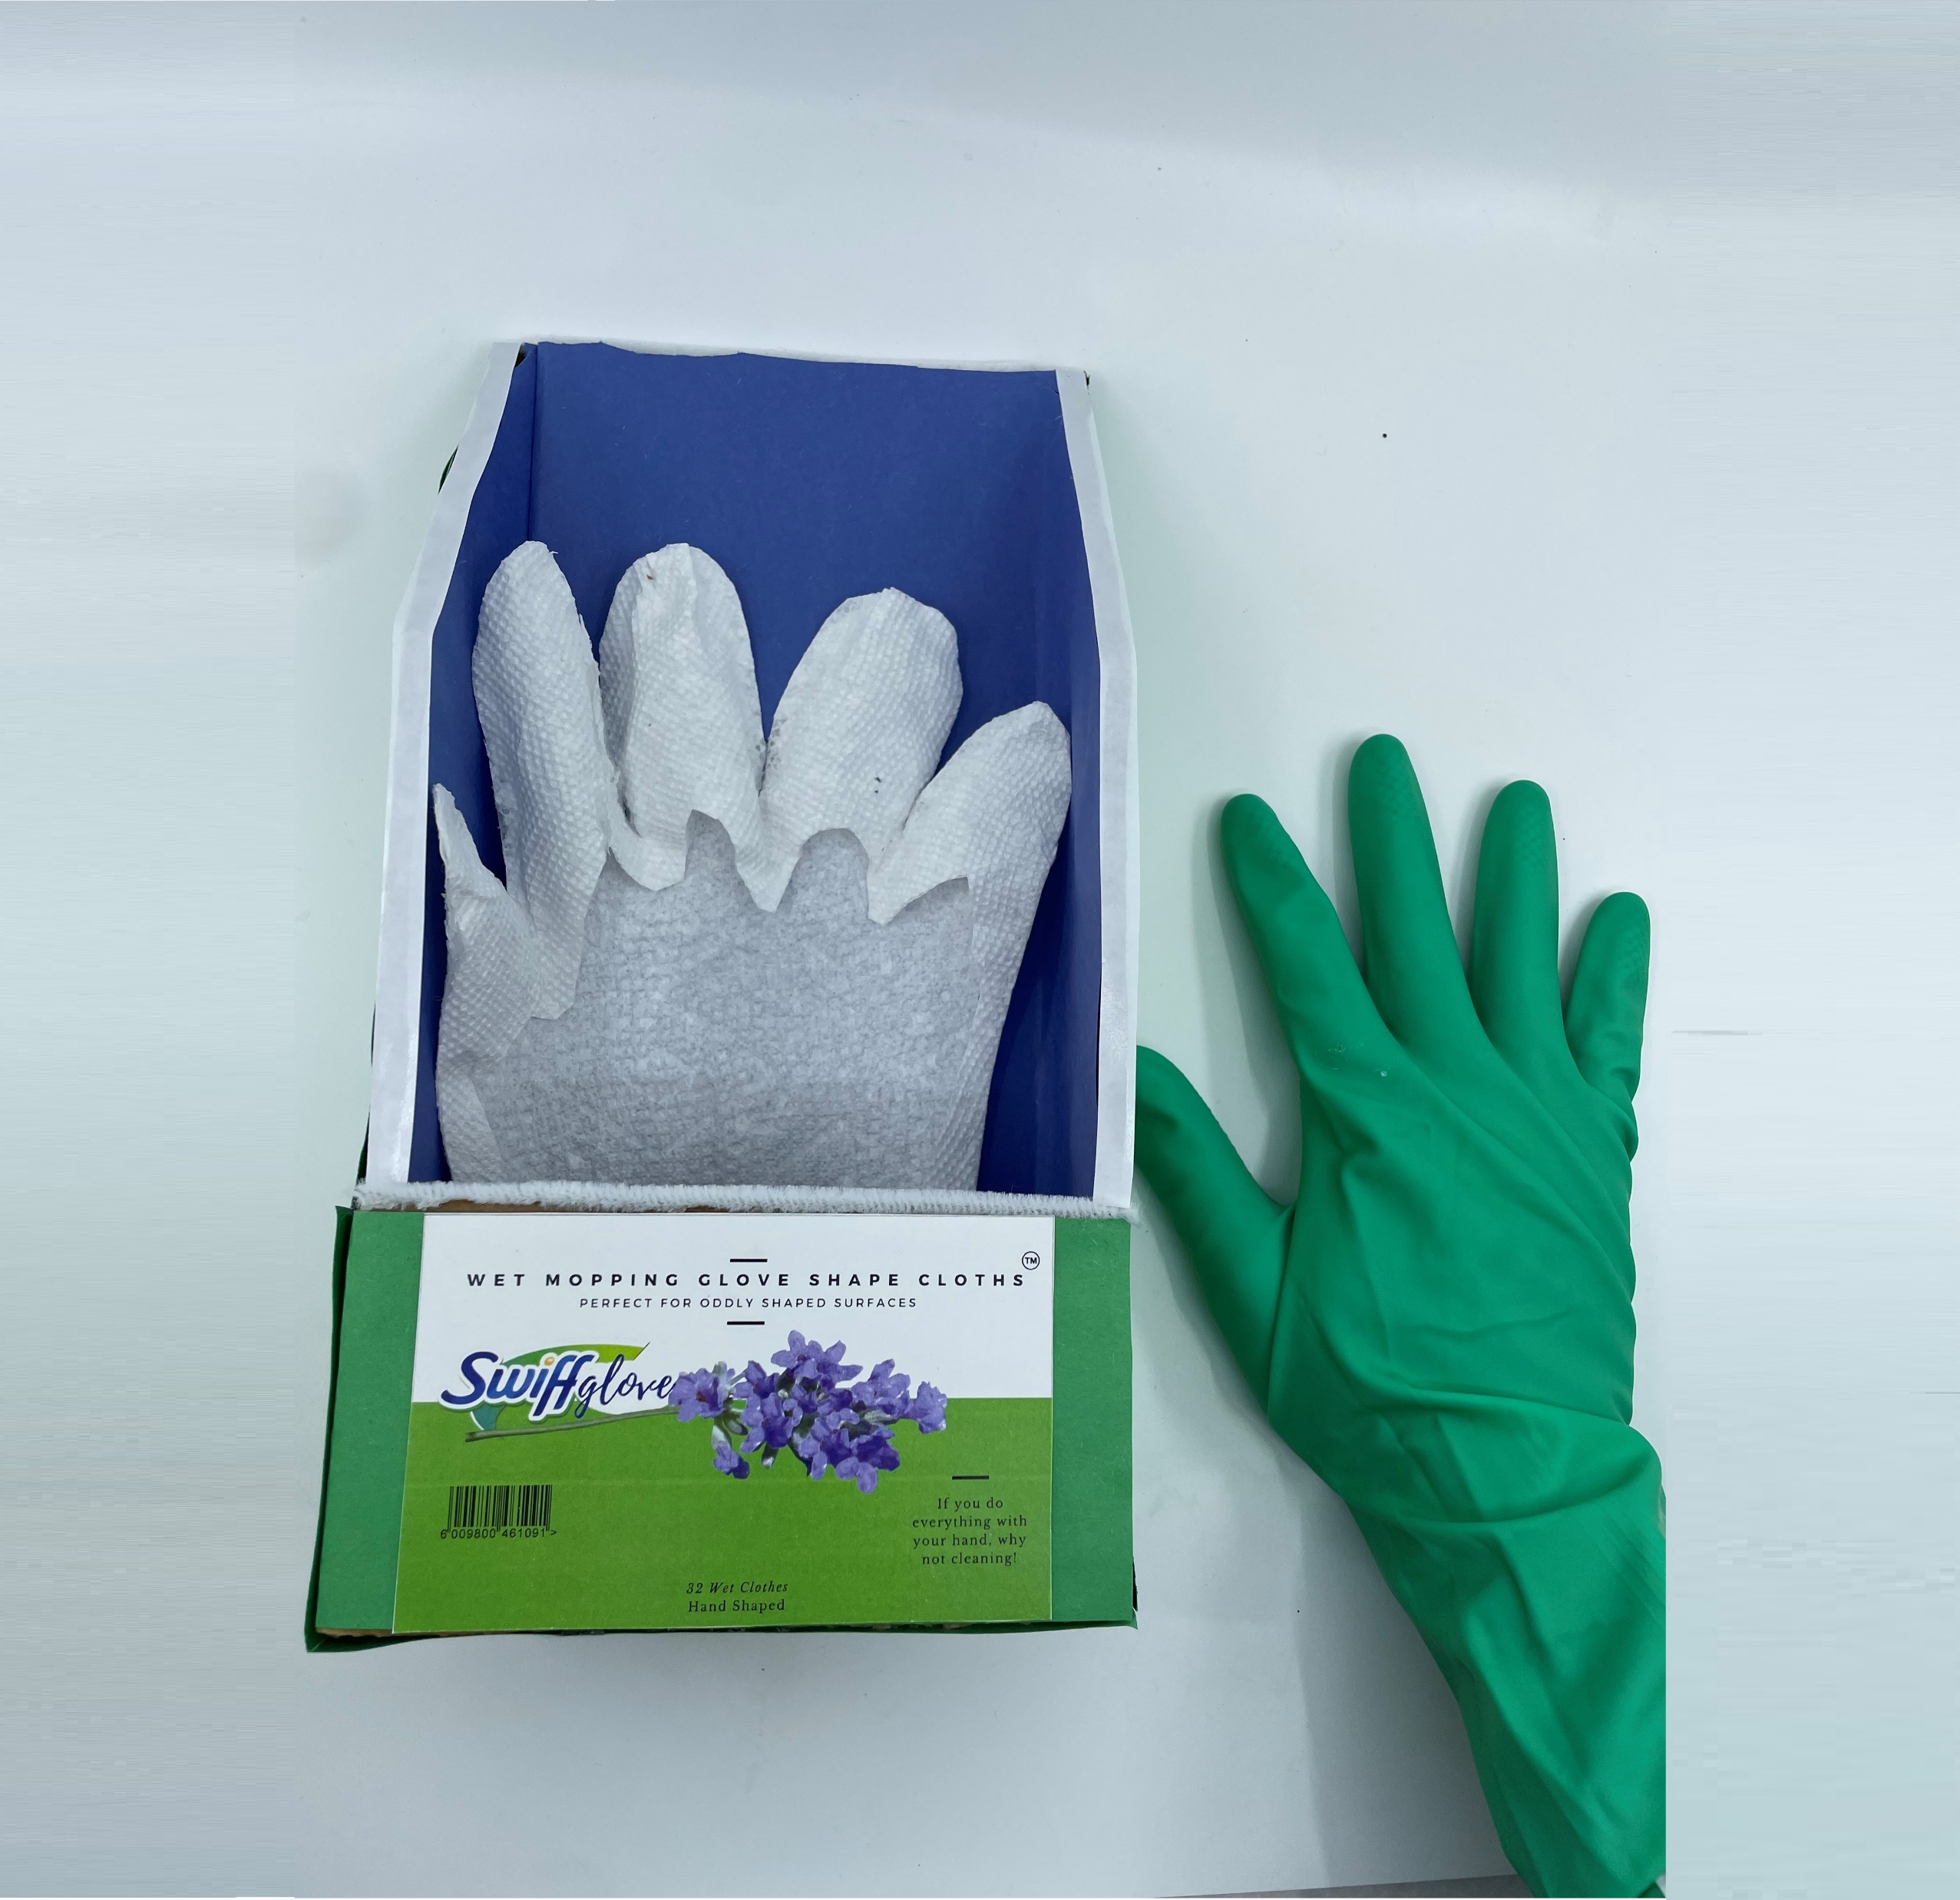

Initial feedback of product
Person 1
“Less trash! I would waste less with this option, the paper is smaller, and you get to reuse the main glove”
“I love that it sticks, it is perfect for the dust in small areas”
Person 2
“I feel this option is more resistant to any liquid, the liquid does not get through easily”
Person 3
“I like the idea, but I feel it is a double expense in two different gloves when I can buy one”
Person 4
“It would help me to reach gaps with my fingers between the stove, refrigerator, etc., I would buy it”
Person 5
18

Slide 21










Customer Journey Map for the “Stay at Home” Mom
“Research and Shopping time!”
“I’ve found it!, It’s so simple!”
“What a mess!”
“This isn’t going to work!”
Oddly-shaped surface.
Ice Cream FREE!
The customer’s child smears ice cream in the crevices of their kitchen cabinets (An oddly shaped surface).
The customer attempts to clean the oddly shaped surface with a crumbled-up paper towel. Can not reach the area and gets wet with the product, fails completely!
The customer resolves to find a solution for these types of problems once and for all. But does a product for something like this even exist?
The customer finds the perfect product – Their own hand! It’s niche, unproven, yet possibly the most convenient product yet.
19

Slide 22
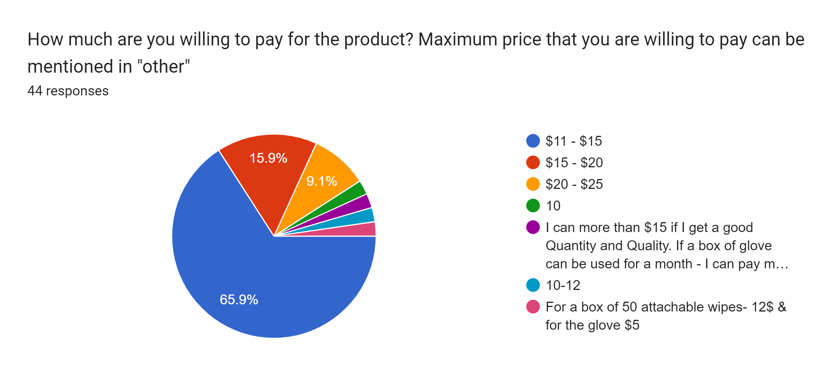
Price Willingness to pay
20

Slide 23
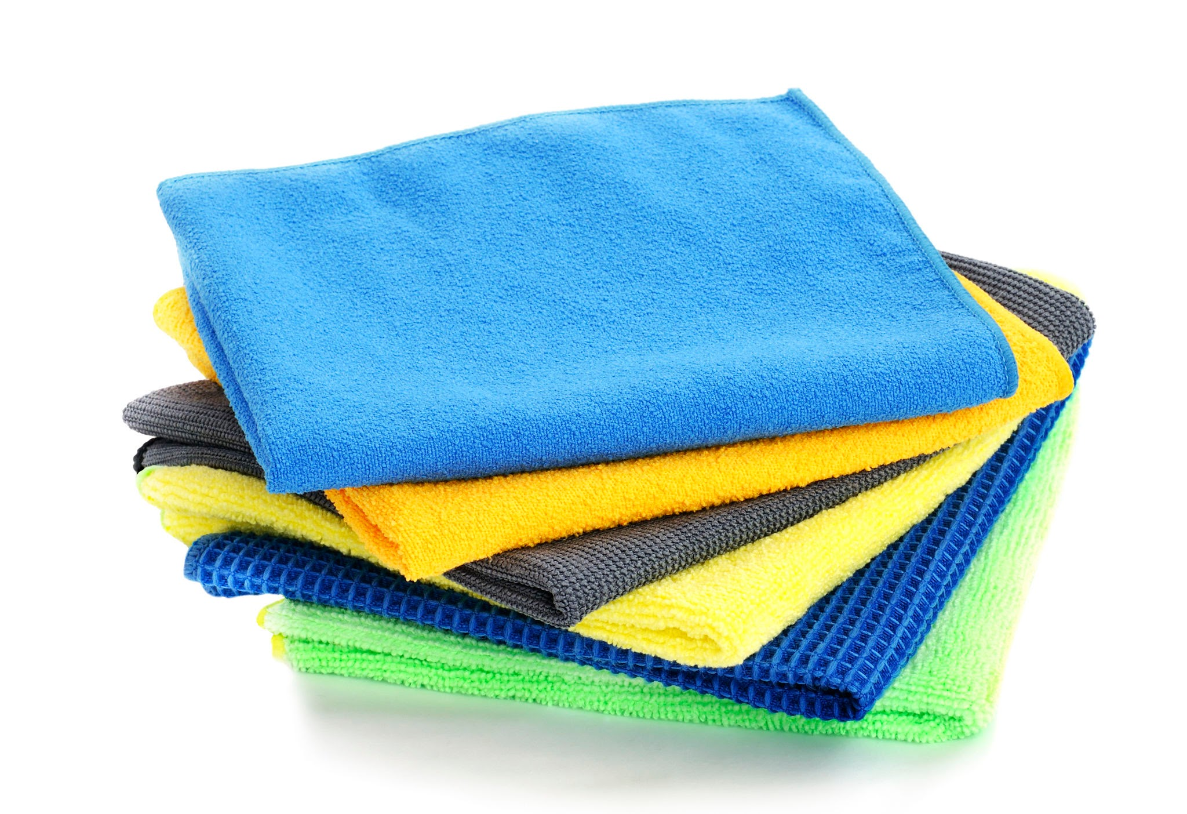
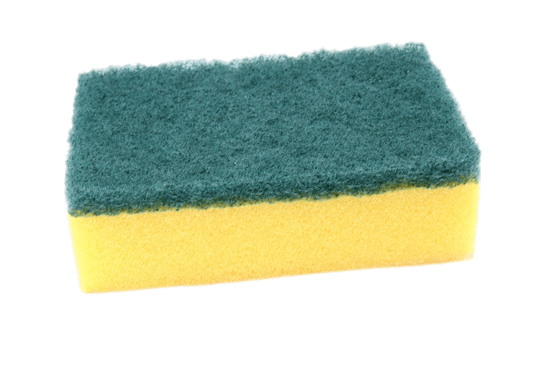
Potential areas of growth
Additional add ons
Other types of products can be sticked in the glove: yellow sponge for washing dishes, microfiber cloths
1
Advantages
Glove in all the house
This product will be part of all the cleaning “to do” at home
Protect from chemicals and bacteria
Now with detergents, grease disinfectants, etc.
Clean odd surfaces
Everywhere!
21

Slide 24
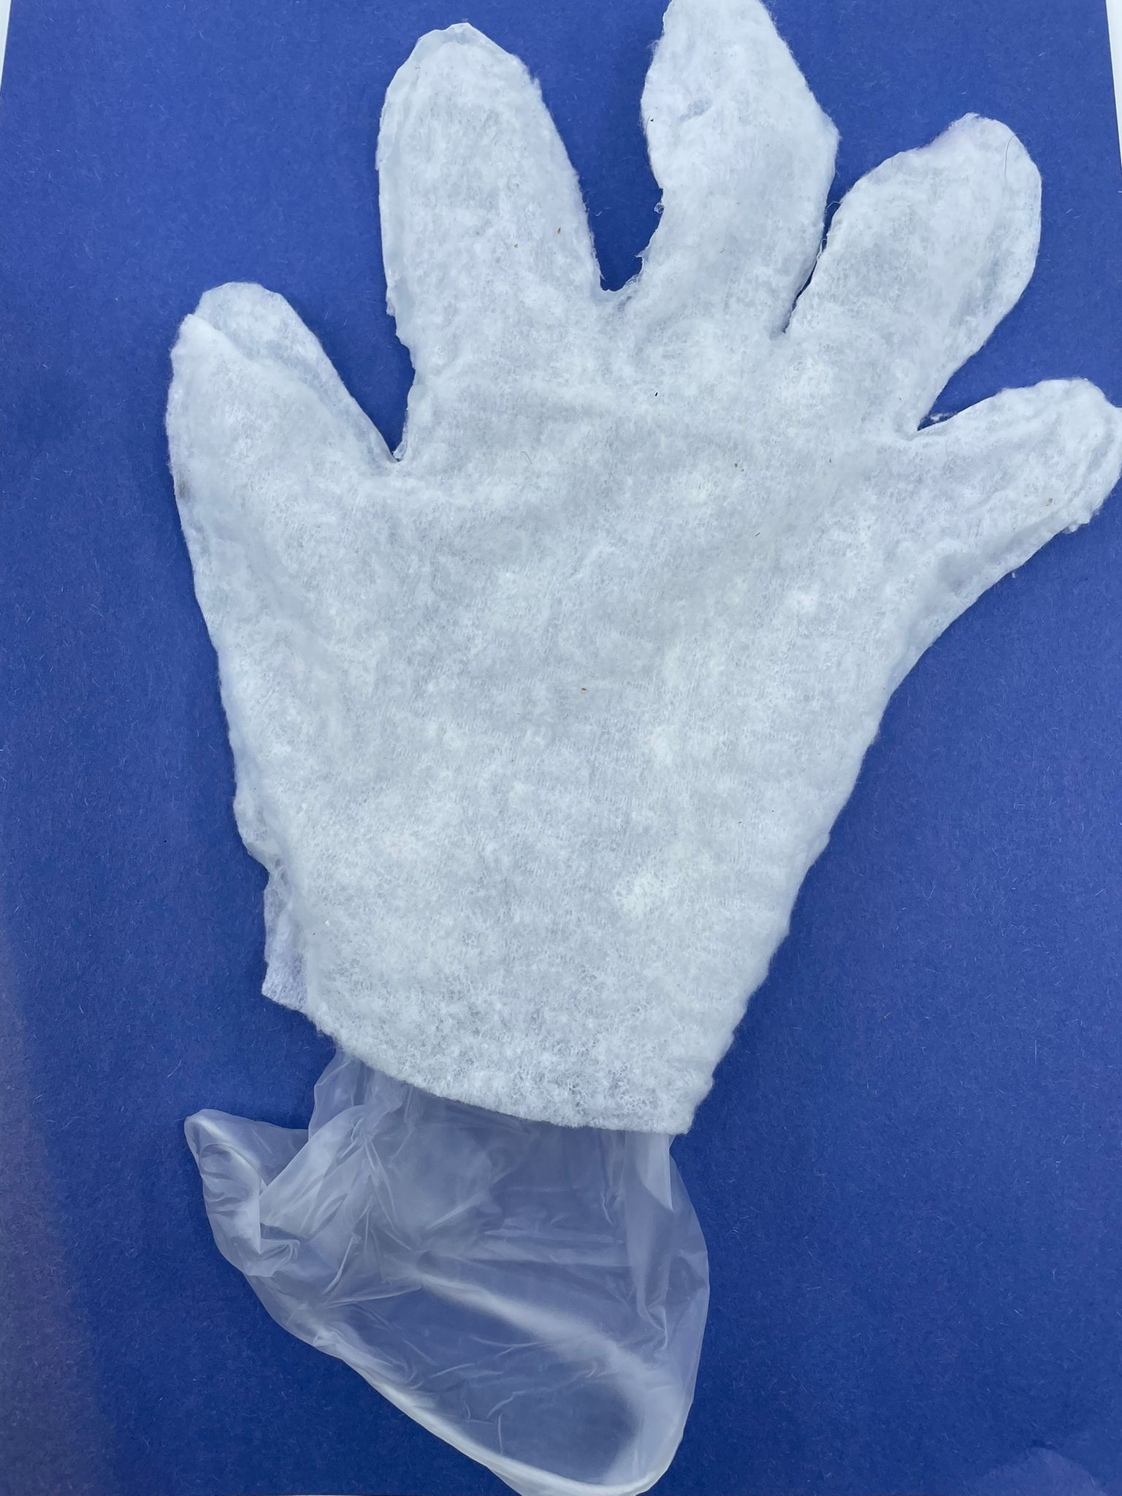
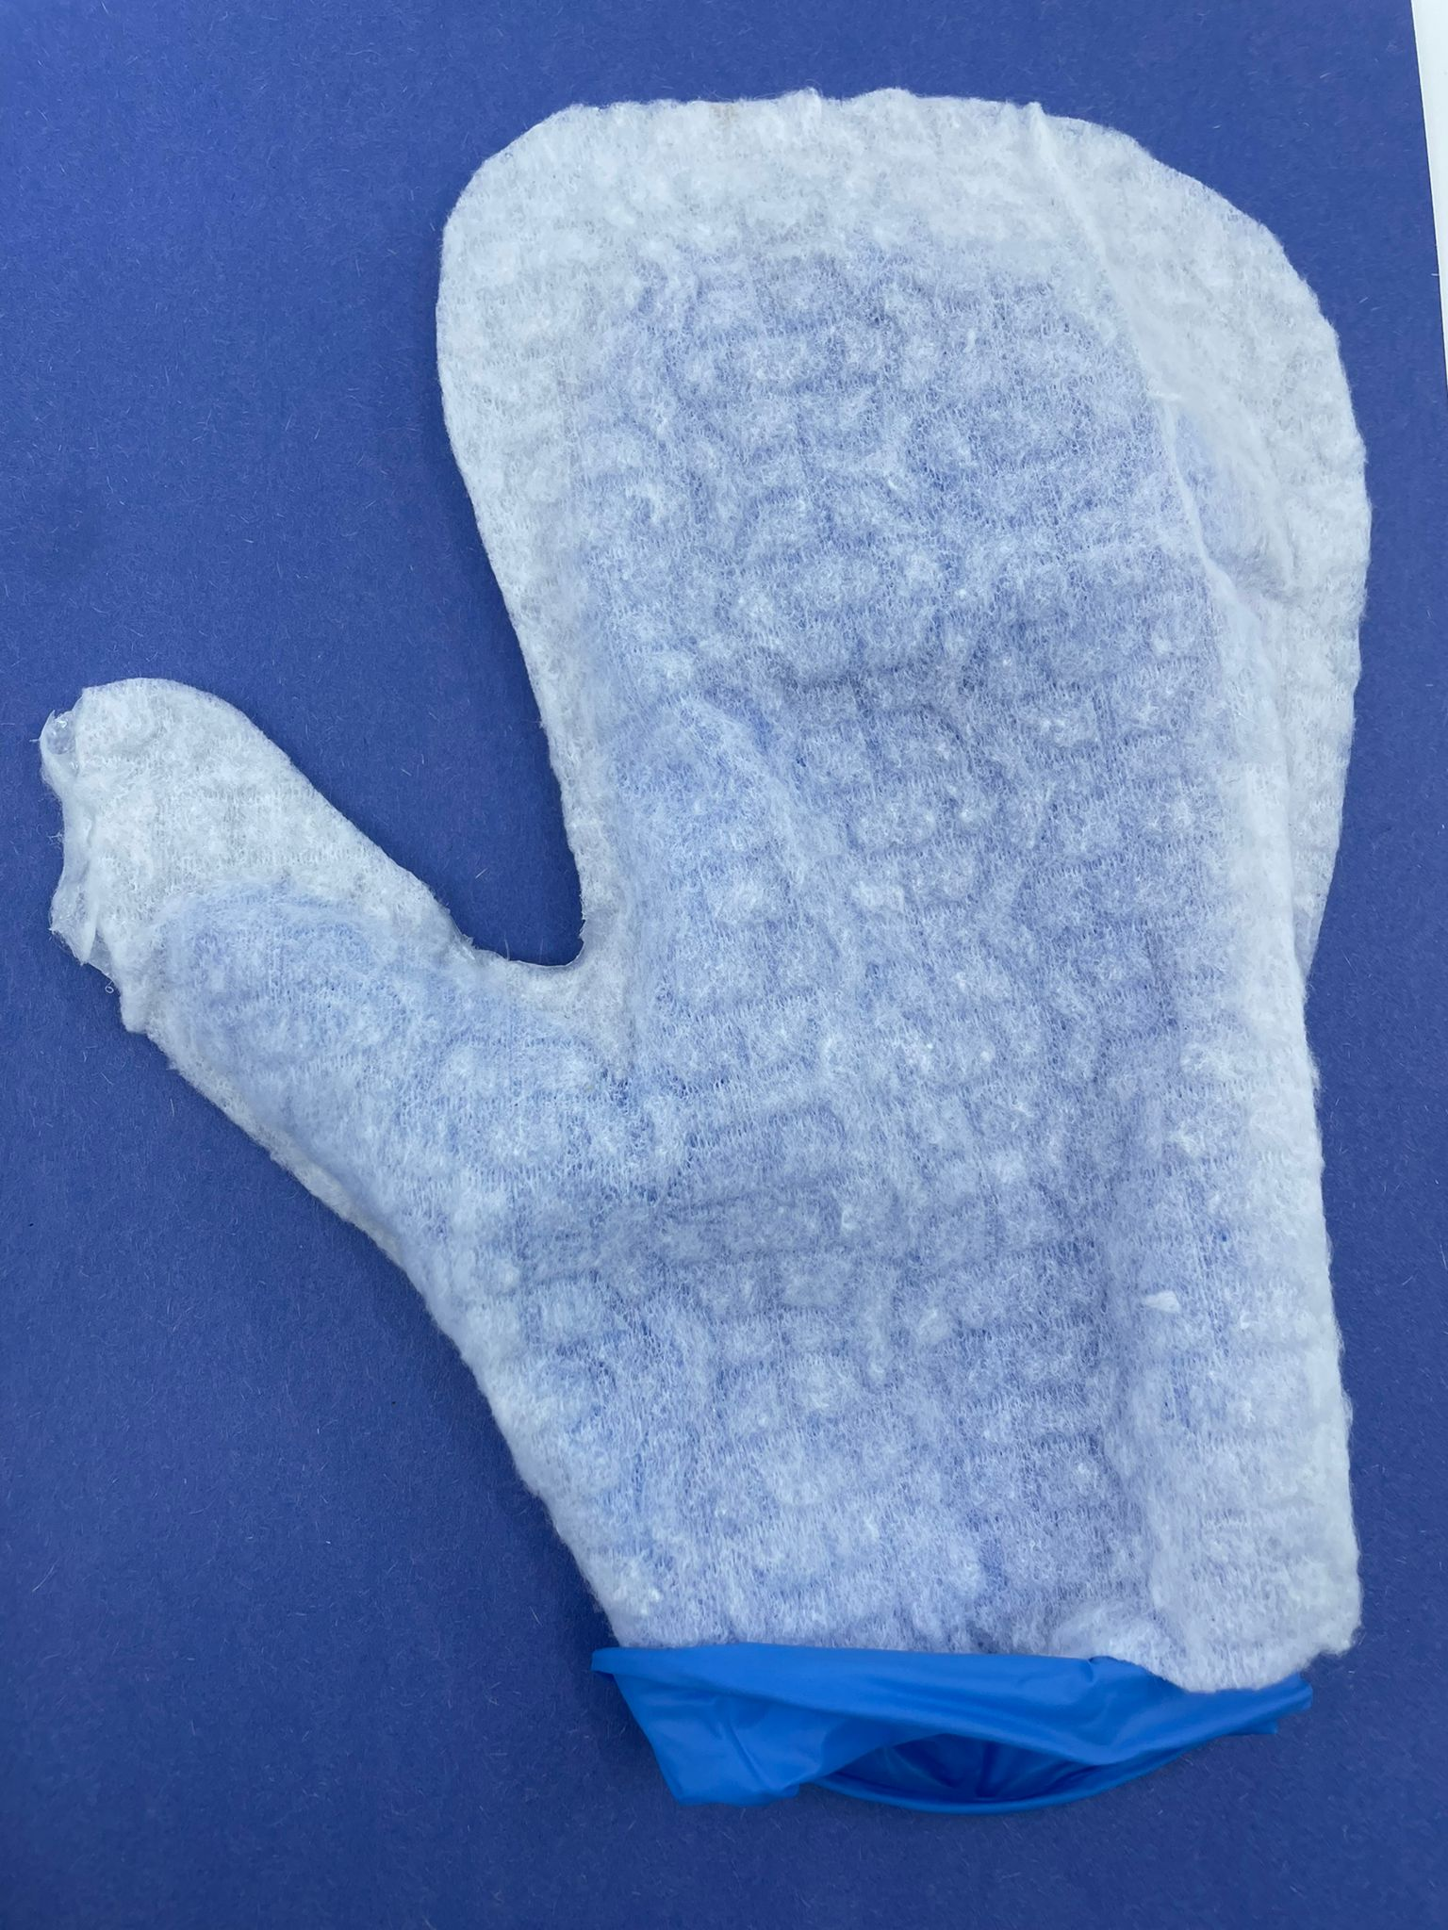
Potential areas of growth
Disposable glove
This product is a glove made from a high-quality dry wipe which can help in cleaning oddly shaped surfaces and crevices, where the hands and fingers can go. The product is to be immediately disposed after use.
2
Advantages
Safety concerns resolved
We have found that customers want two contradictory features – distance from cleaning chemicals and the ability to eliminate bacteria with an almost 100% certainty (which often requires chemicals). With this glove, we solve both issues by removing contact with chemicals.
Elbow Grease
Extremely dirty surfaces often require applied pressure to clean, with many products applied pressure is not often possible. But with a glove, the hand is free to interact with the mess more precisely.
Accessibility
Your hand is the ultimate tool, no device can ever match its ability to follow and outline oddly shaped surfaces. With a cleaning glove, the consumer can have greater access to surfaces that need cleaning.
Option 2
Option 3
22

Slide 25
Target customer frequecy
24

Slide 26
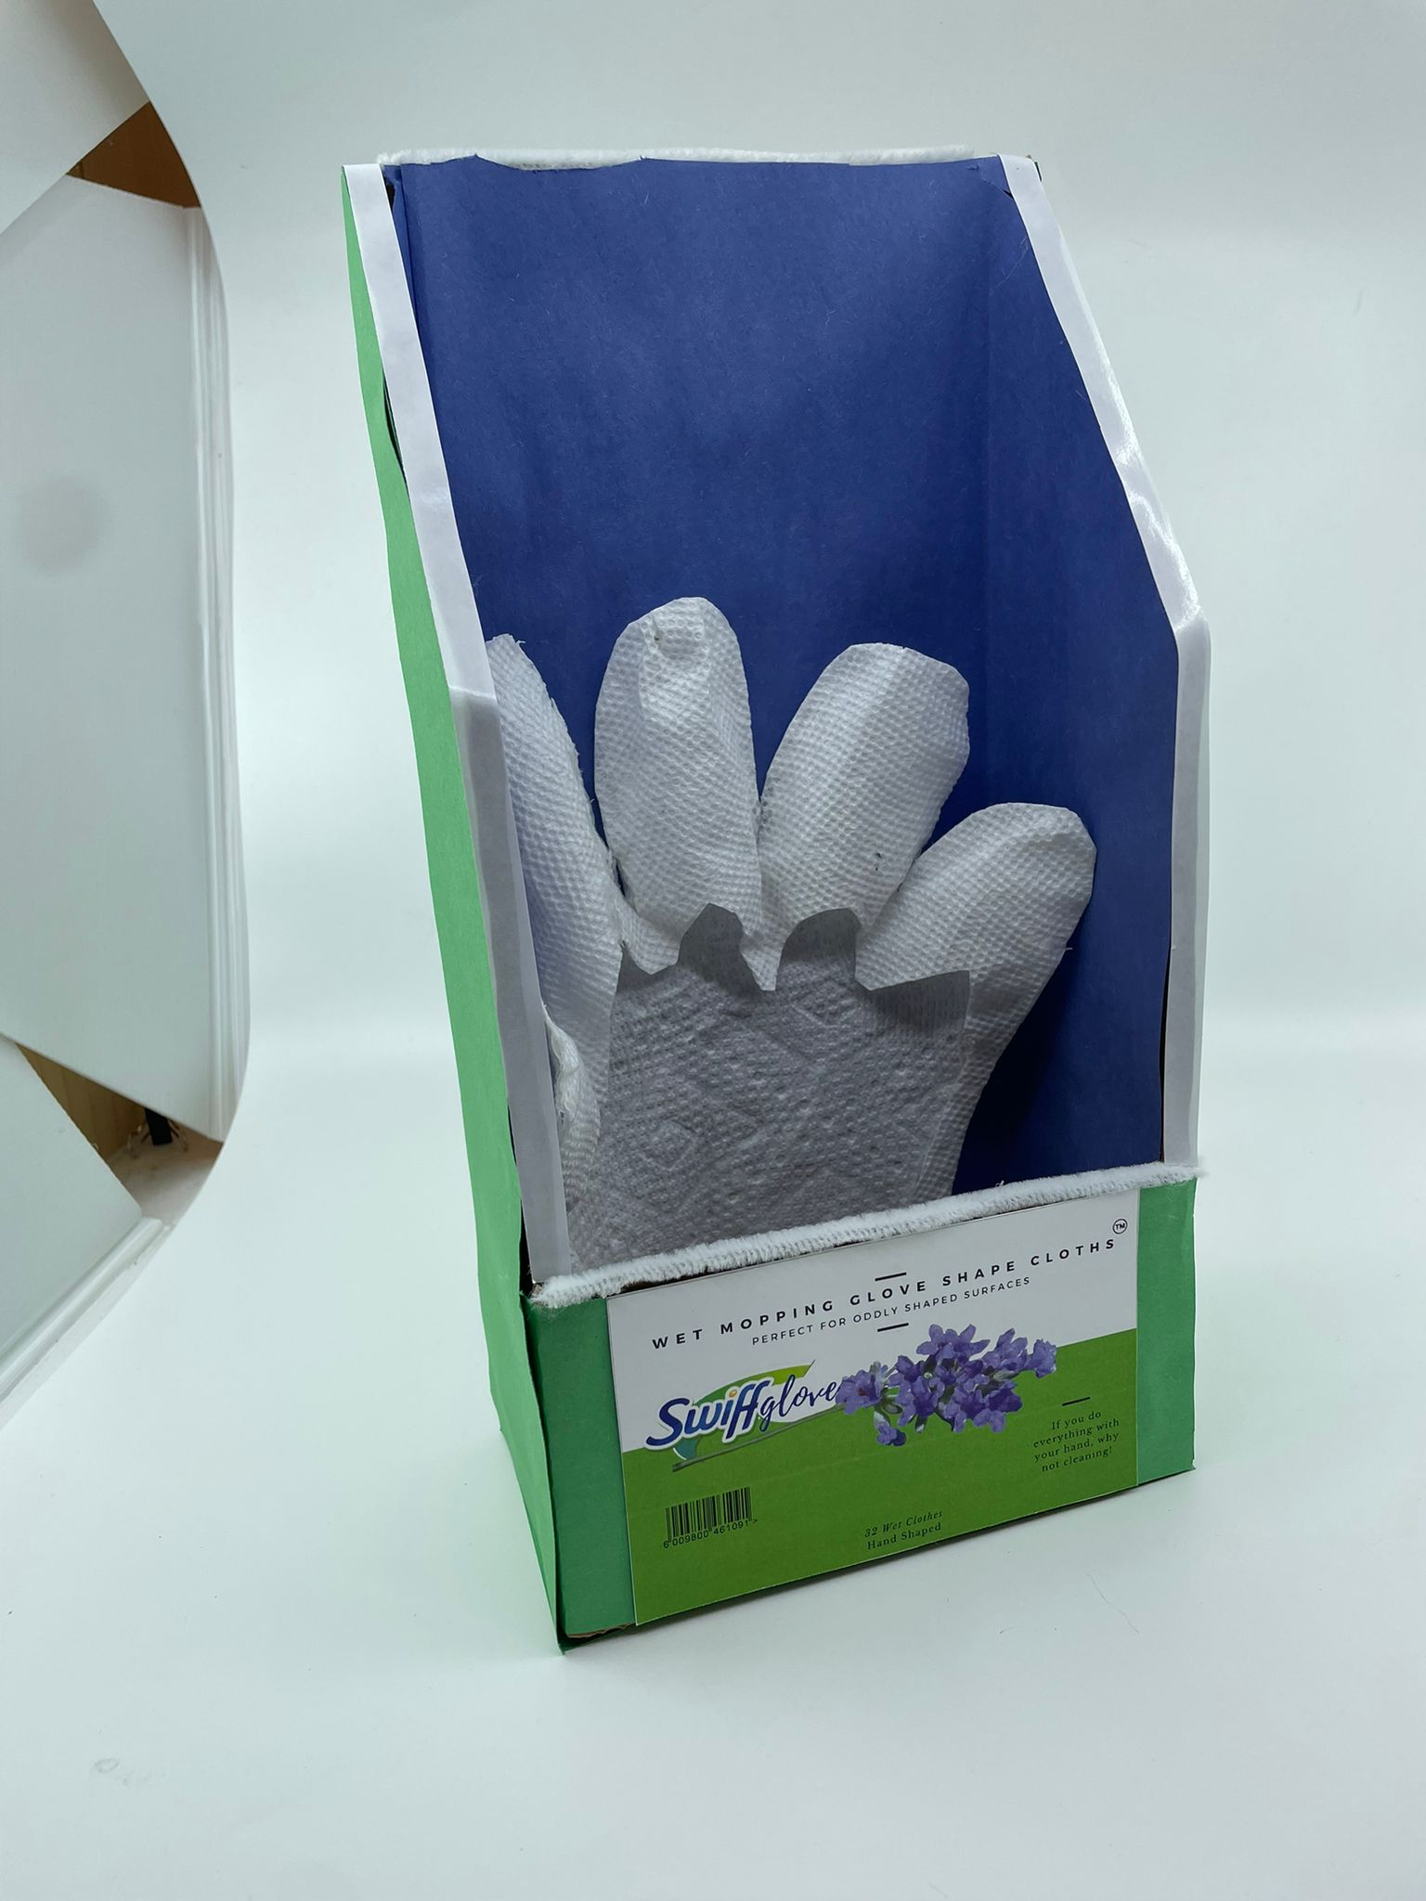
Prototype
25

Slide 27









Business Model Canvas
Key Partners - Retailers - Vendors - Distributors - Suppliers - Media Agencies | Key Activities - Shelf Share & position - Marketing and Sales - Production and distribution | Value Proposition Technical Value: - Single product for multi-cleaning. Business Value - Improvement in customer satisfaction. - Increase in revenue - New product line for P&G - Market Share growth Personal Value - Intuitive use for the customer. -To clean oddly shaped surfaces. - Can handle chemicals with glove - Helps in cleaning hard stains. | Customer Relationships - Rewards and Discounted rates - Product innovation - Brand reputation - Customer loyalty and satisfaction - Ease of use - High-quality Product - Convenient, secure, and hygienic | Customer Segments - Mass market - Household-house wives, professional cleaners, at-home moms, working professionals, students - Hygiene-conscious customers
 | Key Resources Physical Resources - Manufacturing unit - Machinery - Access to retail chains - Distribution Logistics Intellectual Property Resources - Utility/Design Patents, Trademarks Human Resources - Marketing Experts - R&D staff |  | Channels - Big Retailers: Discounters, Hipermarkets, Supermarket, Mass merchandiserd and Warehouses
Cost Structure - Research and development costs - Manufacturing costs - Marketing costs: in point of sale and media - Distribution costs - Physical location - Sales force costs |  | Revenue Streams - Sales of products
26

Slide 28
Financials
Please go to the following link to find the financial calculation and details:
https://docs.google.com/spreadsheets/d/1o7hcui39w6ovKFwvJJCyqkVgVYjIR2r6/edit?usp=sharing&ouid=106599580585035269352&rtpof=true&sd=true

Slide 29
BIBLIOGRAPHY
UN Problem dust
GW Public Health - Potentially Harmful Chemicals Widespread in Household Dust
https://publichealth.gwu.edu/content/potentially-harmful-chemicals-widespread-household-dust
UN Problem dust
Yale School of Public Health - Study identifies potentially harmful substances in household dust
https://ysph.yale.edu/news-article/study-identifies-potentially-harmful-substances-in-household-dust/
Competitive Matrix
Clorox Disinfectant Wipes
http://www.michaelalbert.com/files/112352/Clorox-Disinfecting-Wipes.pdf
Resources for raw materiales of wipe manufacturing
Droid Wipes machine manufacturer
https://www.droidwipes.com/
27

